Slide 1
Project 3
Should I renovate this house?
Lillian

Slide 2
Goals
1. Develop an algorithm to reliably estimate the value of residential houses based on fixed characteristics.
2. Identify characteristics of houses that the company can cost-effectively change/renovate with their construction team.

Slide 3
My approach to dealing with the GarageYrBlt column

Slide 4
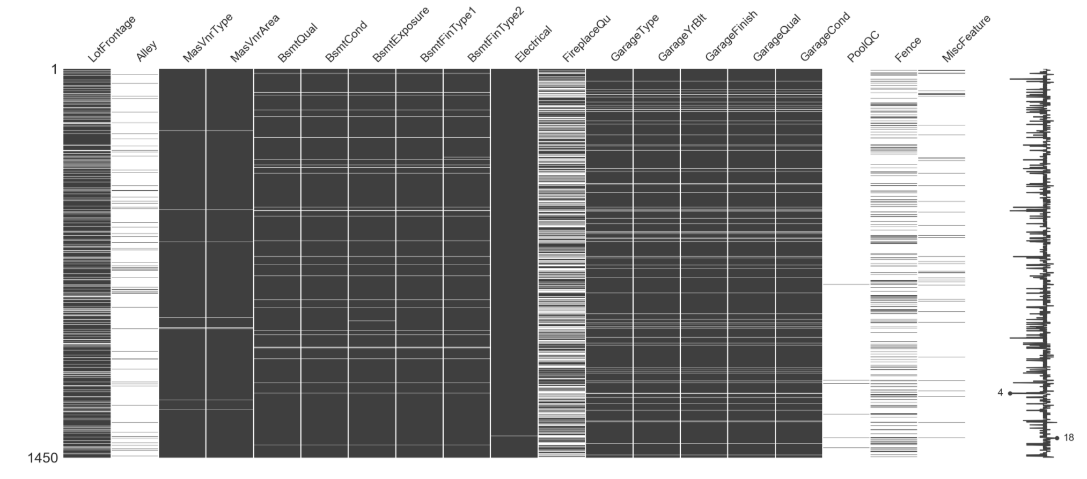
NA columns

Slide 5
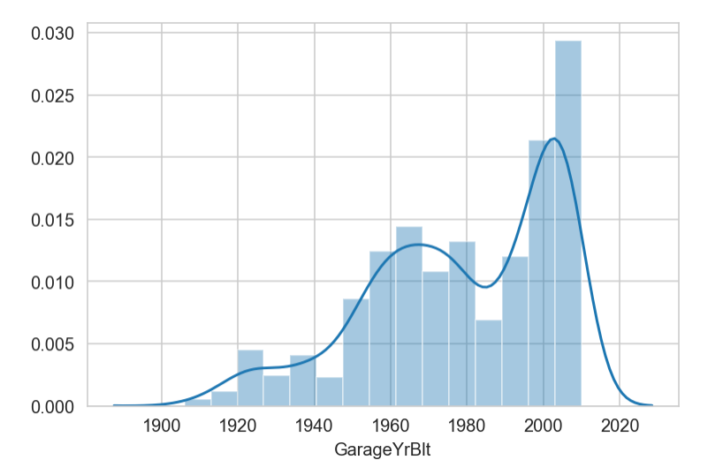
Frequency of GarageYrBlt column

Slide 6
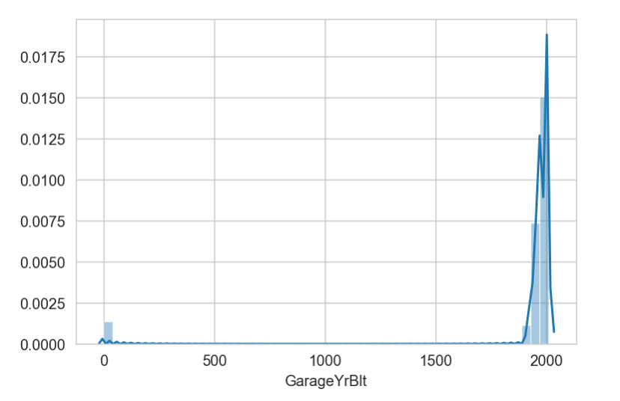
Frequency of GarageYrBlt column with 0 imputed for NA

Slide 7
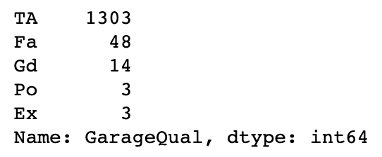
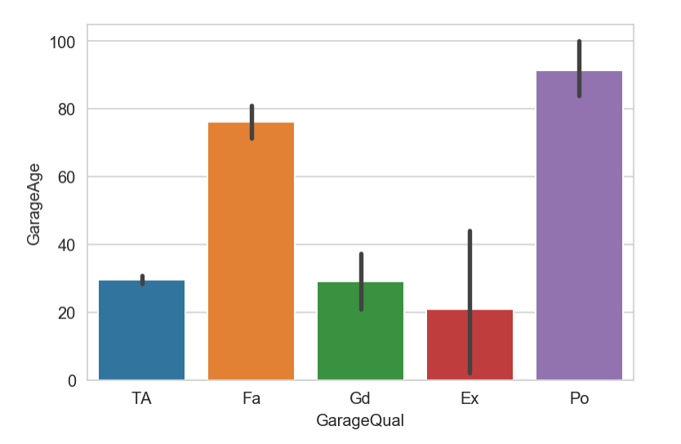
GarageQual vs GarageAge… something looks dodge

Slide 8
First,
If the company was to renovate a garage, major renovations would be the garage door opener and the actual garage door.
Garage door opener lifespan is generally 10-15 years.
Garage door itself should last around 30 years.
Mean age of garage before it probably needs a renovation should be around 22 years.

Slide 9
Then...
By this logic a garage aged:
< 22 years can be considered relatively newly renovated (N)
>= 22 years can be considered moderately in need of reno (M)
>= 44 years can be considered in immediate need of reno (I)
Then we impute “none” where GarageYrBlt has NA values to make dummies out of the categories.

Slide 10
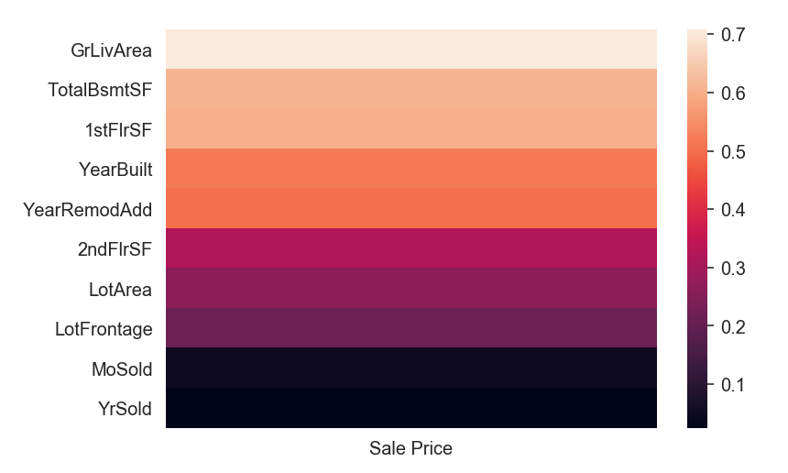
Correlation matrix - top 10 variables

Slide 11
Linear regression
Trained on pre-2010 data

Slide 12
0.8527
(Test)
0.8502
(Train)

Slide 13
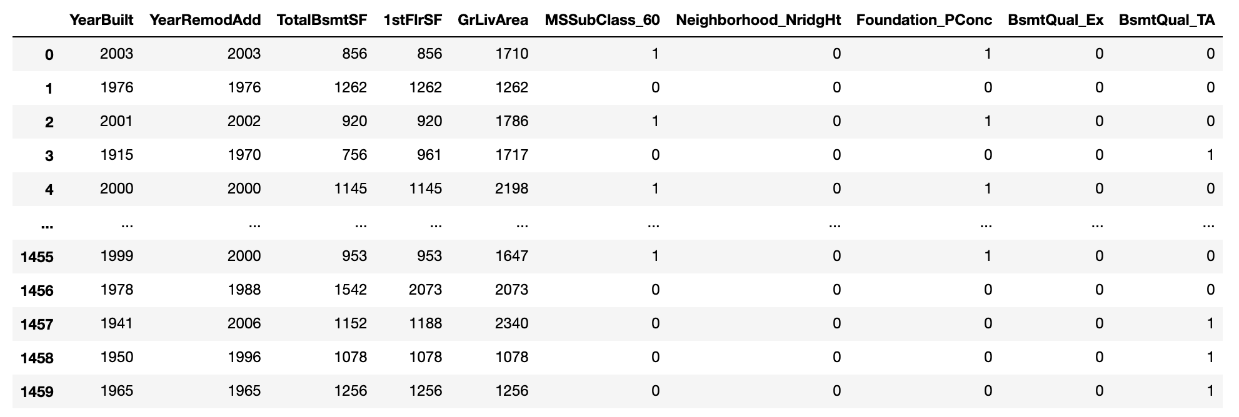
Best fixed predictors for price using SelectKBest
Recursive feature elimination probably would be better

Slide 14
Lasso regression
Also trained on pre-2010 data

Slide 15
0.0943
(Test)
0.0816
(Train)

Slide 16
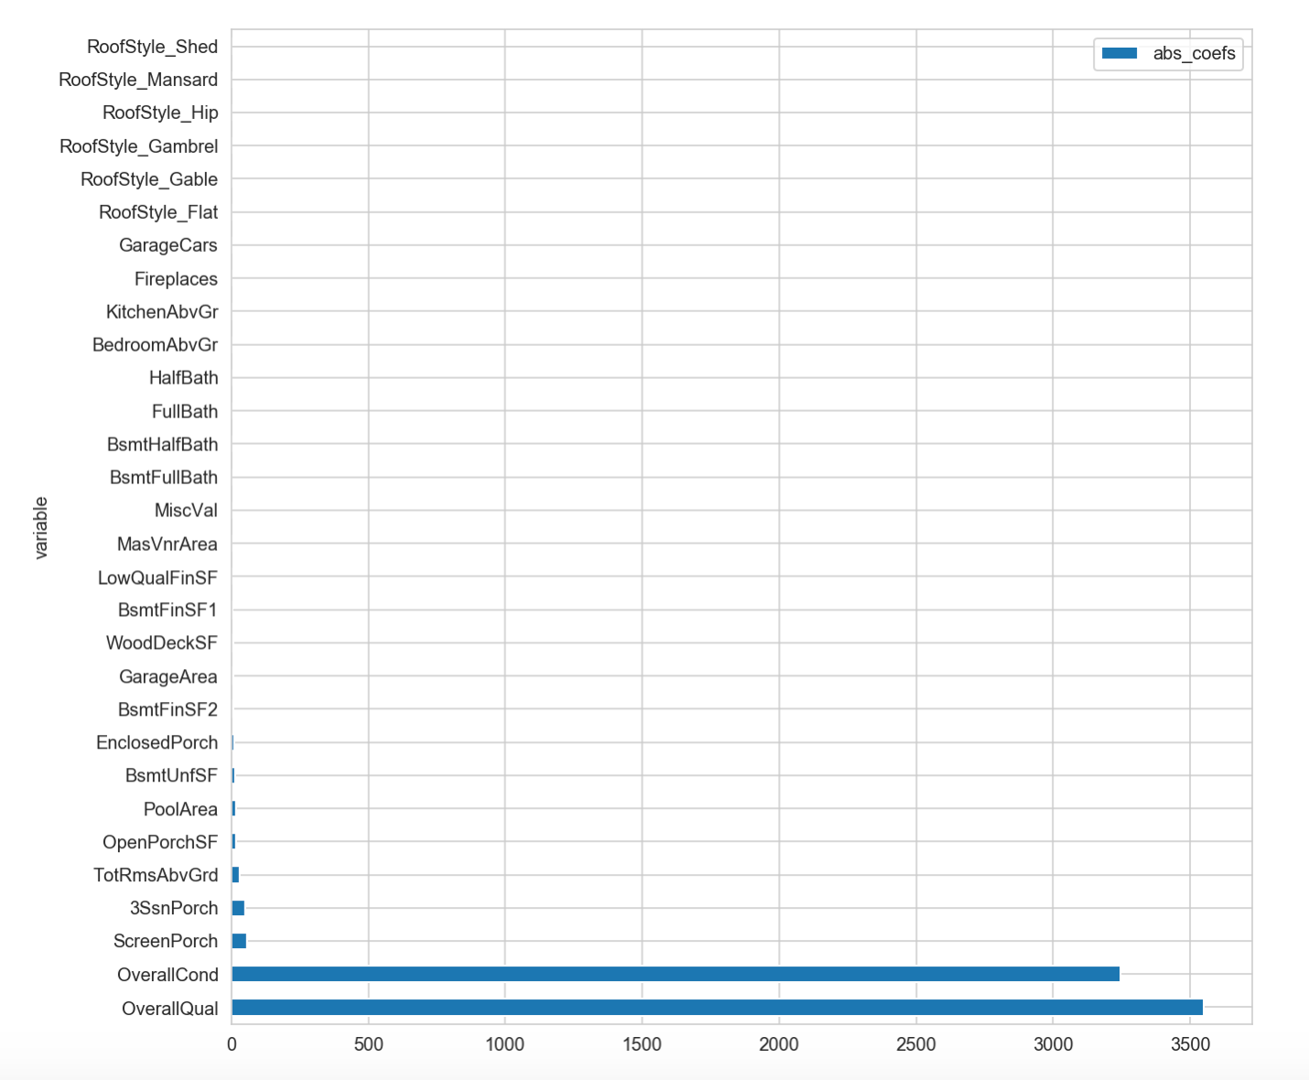
Coefficients of non-fixed variables

Slide 17
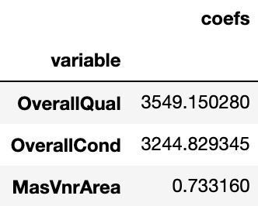
Best non-fixed predictors for sale price

